Slide 1
SMART LENDER - APPLICANT CREDIBILITY PREDICTION FOR LOAN APPROVAL
DOMAIN : APPLIED DATA SCIENCE
SANJAY D - 2019115087
ROHITH M S R - 2019115081
PRAHADEESH K - 2019115066
SAI SRINIVASAN V - 2019115085

Slide 2
PROBLEM STATEMENT
To reduce the manual work in the banking sector a model needs to be designed to analyse whether an individual is fit enough to avail the loan or not.
The main objective is to predict whether a new applicant can be granted the loan or not using models trained on the historical data set.

Slide 3
LITERATURE SURVEY
NAME OF THE PAPER | YEAR AND PUBLICATION | AUTHORS | METHODOLOGIES | PROS | CONS
Machine Learning Based Model for Prediction of Loan Approval | 2022 3rd International Conference on Intelligent Engineering and Management (ICIEM) | B. Lohani, M. Trivedi, R. J. Singh, V. Bibhu, S. Ranjan and P. K. Kushwaha | Logistic Regression | From an analytical viewpoint and constraints on the model is meets all the requirements and can be plugged into any banking systems | For training, logistic regression necessitates a large sample size

Slide 4
LITERATURE SURVEY
NAME OF THE PAPER | YEAR AND PUBLICATION | AUTHORS | METHODOLOGIES | PROS | CONS
Design and Simulation of Loan Approval Prediction Model using AWS Platform | 2021 International Conference on Emerging Smart Computing and Informatics (ESCI) | H. Ramachandra, G. Balaraju, R. Divyashree and H. Patil | Decision Tree, and Random Forest | The banks can easily separate the necessary information from huge amounts of informational collections | Accuracy is mediocre

Slide 5
LITERATURE SURVEY
NAME OF THE PAPER | YEAR AND PUBLICATION | AUTHORS | METHODOLOGIES | PROS | CONS
Prediction of Modernized Loan Approval System Based on Machine Learning Approach | 2021 International Conference on Intelligent Technologies (CONIT) | V. Singh, A. Yadav, R. Awasthi and N. Partheeban | XGBoost, Random Forest | Able to take a wide range of inputs. | Not ideal for special circumstances such as an economic depression or bankruptcy situation.

Slide 6
LITERATURE SURVEY
NAME OF THE PAPER | YEAR AND PUBLICATION | AUTHORS | METHODOLOGIES | PROS | CONS
Swindle: Predicting the Probability of Loan Defaults using CatBoost Algorithm | 2021 5th International Conference on Computing Methodologies and Communication (ICCMC) | S. Barua, D. Gavandi, P. Sangle, L. Shinde and J. Ramteke | CatBoost Algorithm | High Accuracy | For training, a large sample size Is needed

Slide 7
LITERATURE SURVEY
NAME OF THE PAPER | YEAR AND PUBLICATION | AUTHORS | METHODOLOGIES | PROS | CONS
Real Time Data Science Decision Tree Approach to Approve Bank Loan from Lawyer’s Perspective | 2020 19th IEEE International Conference on Machine Learning and Applications (ICMLA) | D. P. Rajesh, M. Alam, M. Tahernezhadi, C. Vikram and P. N. Phaneendra | Decision Tree | Algorithm is perfectly working under the condition of (1:1) types of documents and the execution time is less as compared to the other type of documents. | Success rate needs to be increased for other types of documents too.

Slide 8
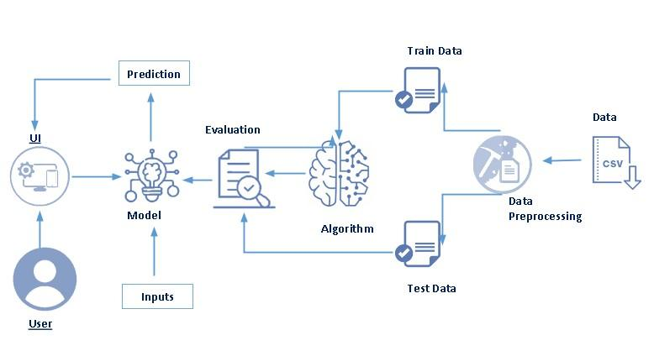
ARCHITECTURAL DIAGRAM

Slide 9
REFERENCES
[1] B. P. Lohani, M. Trivedi, R. J. Singh, V. Bibhu, S. Ranjan and P. K. Kushwaha, "Machine Learning Based Model for Prediction of Loan Approval," 2022 3rd International Conference on Intelligent Engineering and Management (ICIEM), 2022, pp. 465-470, doi: 10.1109/ICIEM54221.2022.9853160.
[2] H. Ramachandra, G. Balaraju, R. Divyashree and H. Patil, "Design and Simulation of Loan Approval Prediction Model using AWS Platform," 2021 International Conference on Emerging Smart Computing and Informatics (ESCI), 2021, pp. 53-56, doi: 10.1109/ESCI50559.2021.9397049.
[3] V. Singh, A. Yadav, R. Awasthi and G. N. Partheeban, "Prediction of Modernized Loan Approval System Based on Machine Learning Approach," 2021 International Conference on Intelligent Technologies (CONIT), 2021, pp. 1-4, doi: 10.1109/CONIT51480.2021.9498475.

Slide 10
REFERENCES
[4] S. Barua, D. Gavandi, P. Sangle, L. Shinde and J. Ramteke, "Swindle: Predicting the Probability of Loan Defaults using CatBoost Algorithm," 2021 5th International Conference on Computing Methodologies and Communication (ICCMC), 2021, pp. 1710-1715, doi: 10.1109/ICCMC51019.2021.9418277.
[5] D. P. Rajesh, M. Alam, M. Tahernezhadi, C. Vikram and P. N. Phaneendra, "Real Time Data Science Decision Tree Approach to Approve Bank Loan from Lawyer’s Perspective," 2020 19th IEEE International Conference on Machine Learning and Applications (ICMLA), 2020, pp. 921-929, doi: 10.1109/ICMLA51294.2020.00150.

Slide 11
REFERENCES
[6] Loan Approval Prediction Machine Learning,
from https://www.analyticsvidhya.com/blog/2022/02/loan-approval-prediction-machine-learning/
[7] Loan Approval Prediction, International Research Journal of Engineering and Technology (IRJET) (April 2022), from https://www.irjet.net/archives/V9/i4/IRJET-V9I4118.pdf/
[8] https://github.com/ParthS007/Loan-Approval-Prediction/

Slide 12
REFERENCES
[9] How to predict Loan Eligibility using Machine Learning Models. (2020, September). Towards Data Science, Medium from https://towardsdatascience.com/predict-loan-eligibility-using-machine-learning-models-7a14ef904057/
[10] https://www.coursera.org/projects/loan-approval-prediction-using-neural-networks/
[11] https://deepnote.com/@rhishab-mukherjee/Loan-Prediction-Project-TermPaper-54f48ea6-2cb0-4aee-8565-e3767caf1fba/

